Slide 1
INTRODUCTION
The aim of the ATM Simulation System project is to build a python based ATM (Automated Teller Machine) Simulation System. The introduction of ATM’s by various banks have brought about freedom from the interminable queues in front of withdrawal counters at banks. This ATM Simulation System requires the constant updating of records between the bank servers and a spread out network of ATM’s .
Security is the foundation of a good ATM system. This system will provide for secure authenticated connections between users and the bank servers . The whole process will be automated right from the PIN (Personal Identification Number) validation to transaction completion. ATM Simulation System will enable two important features of an ATM, Reduction of human error in the banking system and the possibility of 24 hour personal ba- nking . The card details and PIN database will be a secure module that will not be open to routine maintenance,the only possibility of access to this database will be through queries raised from an ATM in the presence of a valid bank ATM card.

Slide 2
PROBLEM STATEMENT
The problem statement here is to create a Atm simulator in python with gui.
In this project the simulation has withdrawl function,deposit function,and exit.
In this project there are four buttons Clear,Delete,Ok,Insert card.
The project also displays balance amount in Atm Simulator.
The project also has password function.
The project also gives wrong password .

Slide 3
ALGORITHM / STEP(Explain the different modules/functions used)
1) We have run the program in python IDLE
2) Our project is based on the ATM SIMULATION
3) The functions of Atm simulation are:-
Enter the card and password correctly
Deposit : this function helps us to deposit the money
Withdrawal : Through this function we can take our money from the machine
Exit : this function helps us to terminate the process

Slide 4
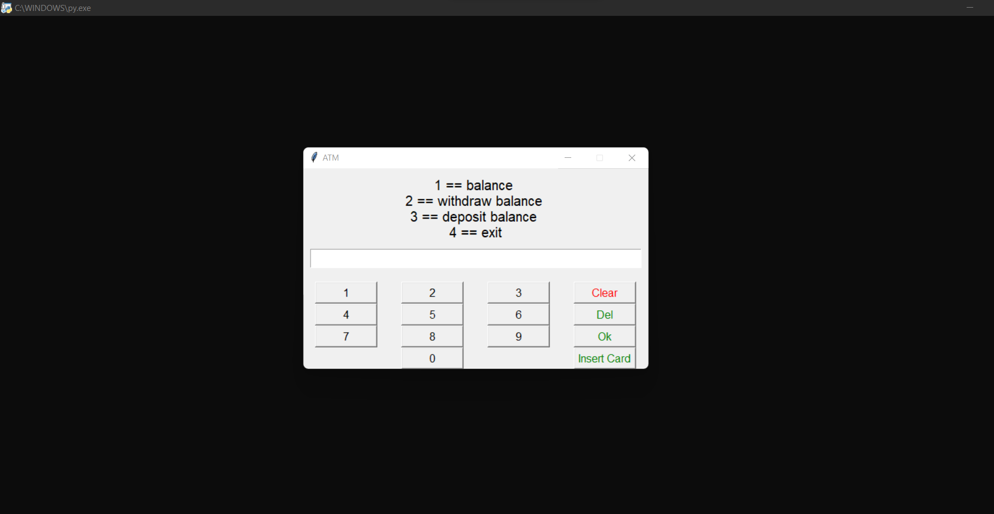
RESULTS (SNAPSHOTS)

Slide 5
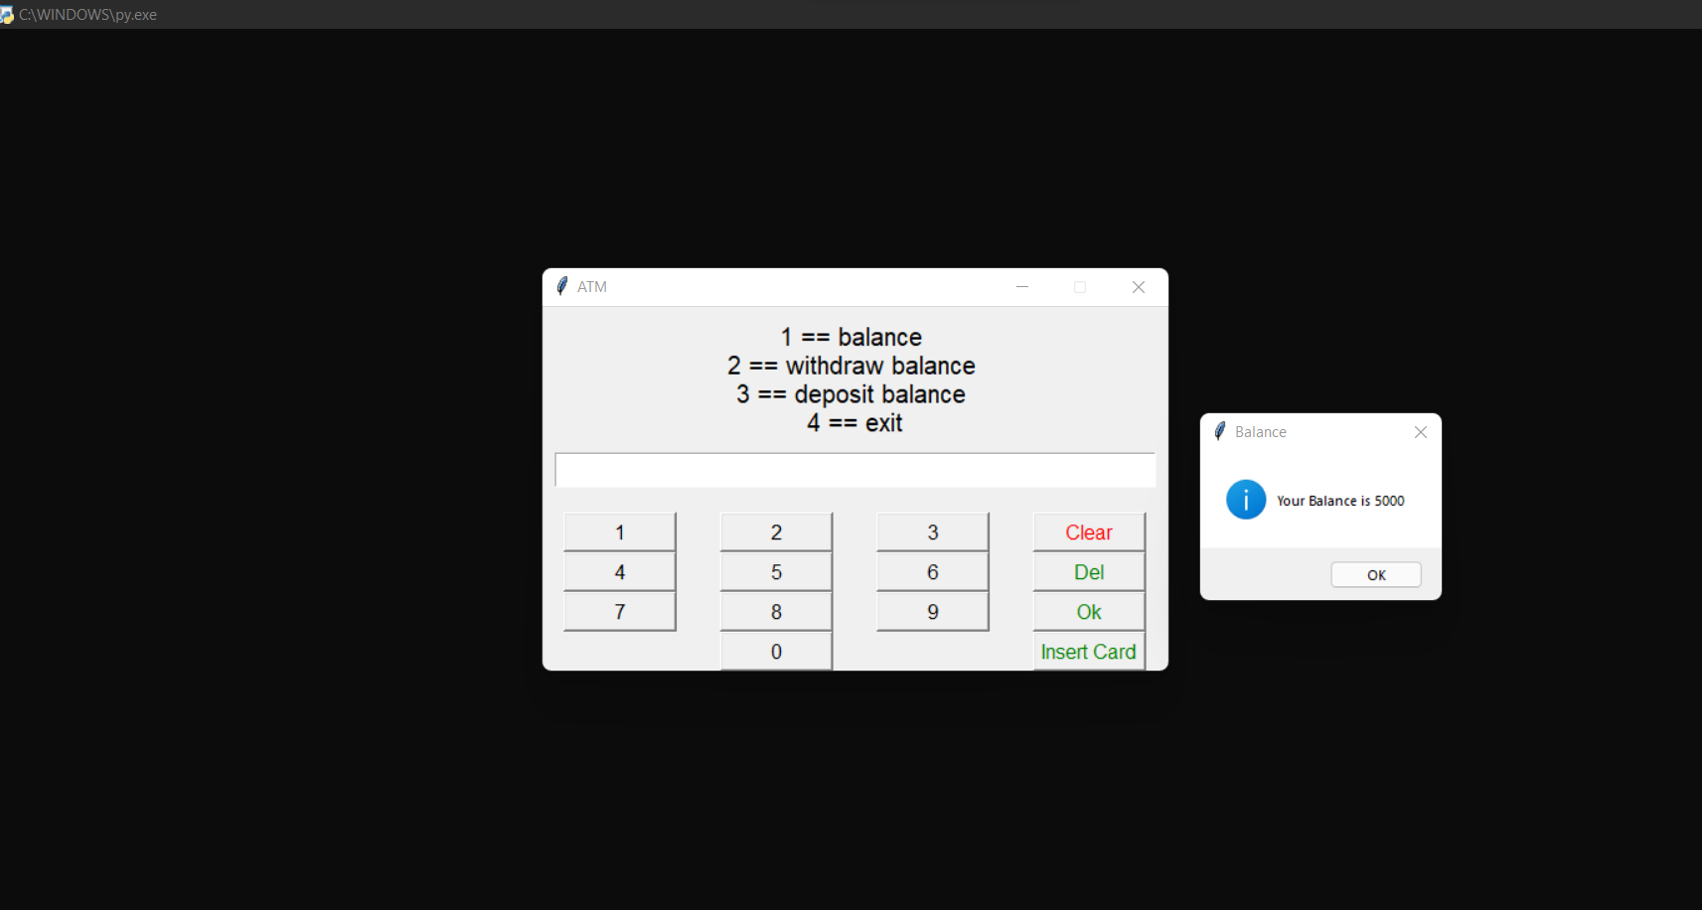
RESULTS (SNAPSHOTS)

Slide 6
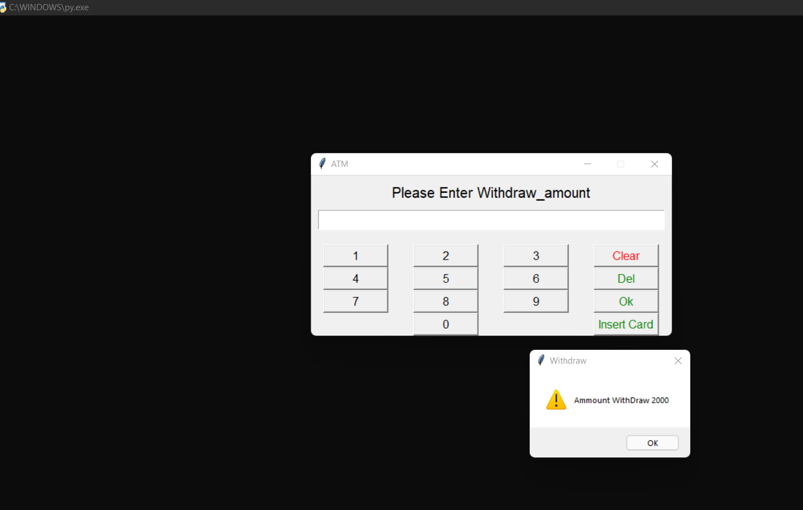
RESULTS (SNAPSHOTS)

Slide 7
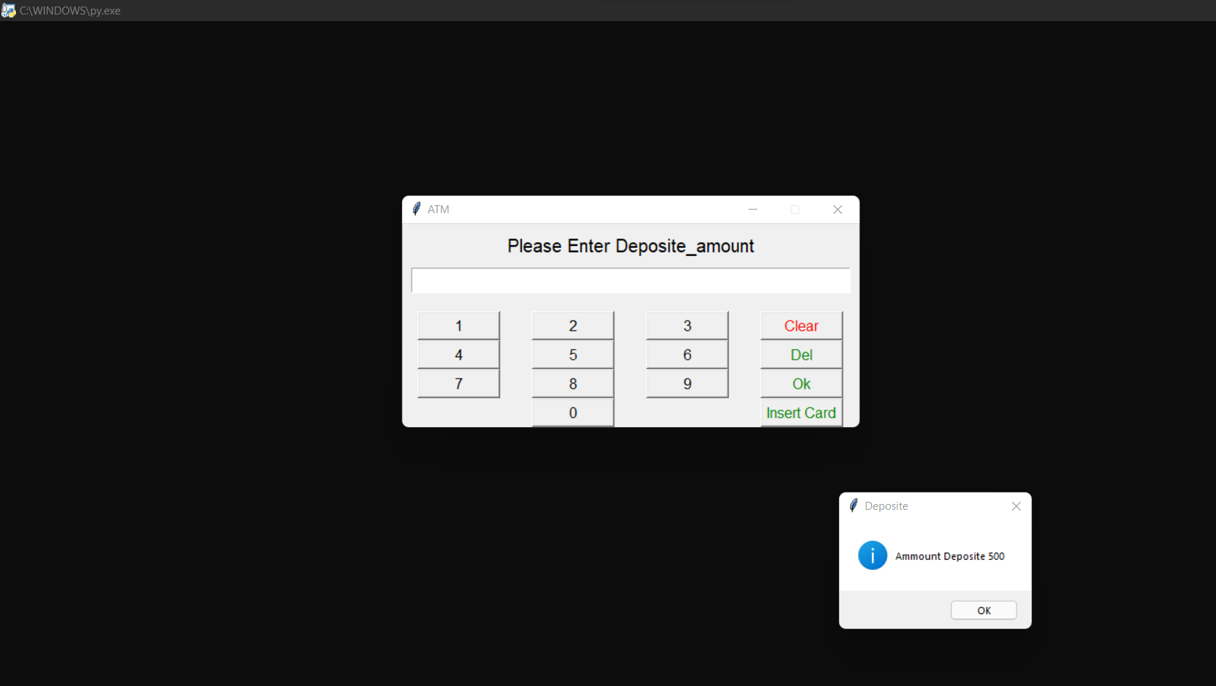
RESULTS (SNAPSHOTS)

Slide 8
CONCLUSION AND FUTURE SCOPE
We have successfully completed our mini project ‘ATM Simulation’ in python.
We have performed operations like 1) Withdrawal 2) Cash Deposit 3) Pin entry 4)exit
Time Taken to complete the project is roughly two weeks.

